Slide 1
Machine Learning
Lesson 9: Recommender Systems

Slide 2

Theory of Recommender Systems
Collaborative Filtering
User Based Nearest Neighbour
Item Based Nearest Neighbour
Cosine and Adjusted Cosine Similarity
Association Rule Mining
Apriori Algorithm

Slide 3
By the end of this lesson, you will be able to:
Build recommender model using python
Understand mechanism of association rule mining
Demonstrate apriori algorithm

Slide 4
Recommender Systems
Topic 1: Introduction
Notes:
Trainer Notes: Explain the following:
Give an introduction to recommender systems from marketing perspective

Slide 5
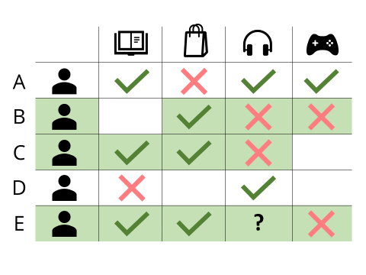
Recommender Systems
Recommender system is an information filtering technique, which provides users with recommendations, which they might be interested in.
Notes:
Trainer Notes: Explain the following:
Define and explain recommender systems with respect to the below image

Slide 6

Recommender Systems: Solution
Recommender systems acts as a solution for your day to day choices
Which websites will you find interesting?
Which digital camera should you buy?
Which degree and university are best for your future?
Which book should you buy for your next vacation?
Which is the best investment for supporting the education of your children?
What is the best holiday for you and your family?
Notes:
Trainer Notes: Explain the following:
How recommender systems solve our day to day problems with respect to the above slide

Slide 7
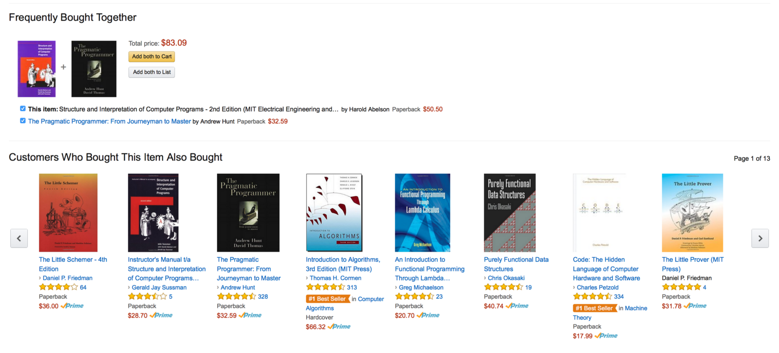
Recommender Systems: Example
Notes:
Trainer Notes: Explain the following:
Explain the above example of book recommendation on amazon

Slide 8
Success of Recommendation Systems
Prediction Perspective
Predicts to what degree a user likes an item
Most popular evaluation scenario in research
Different Aspects
Depends on domain and purpose
No holistic evaluation scenario exists
Success and Purpose of Recommendation Systems
Interaction Perspective
Gives users a good feeling
Educates users about the product domain
Retrieval Perspective
Reduces search costs
Provides correct proposals
Conversion Perspective
Commercial Situations
Increases hit and clickthrough, lookers to bookers rates
Recommendation Perspective
Identifies items from the long tail
Users did not know about their existence
Notes:
Trainer Notes: Explain the following:
Each of the purposes of recommendation systems which leaded to its success

Slide 9
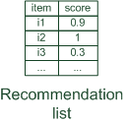

Paradigms of Recommendation Systems
Recommender systems reduce information overload by estimating relevance
Notes:
Trainer Notes: Explain the following:
The above scenario where the most relevant item is recommended

Slide 10


Paradigms of Recommendation Systems (Contd.)
Personalized Recommendations: The most relevant item is recommended based on the user profile and contextual parameters
Notes:
Trainer Notes: Explain the following:
The above scenario where the most relevant item is recommended based on the user profile and contextual parameters (personalized recommendations)

Slide 11

Paradigms of Recommendation Systems (Contd.)
Collaborative: “Recommends what's popular among your peers"
Notes:
Trainer Notes: Explain the following:
The above scenario where the most relevant item is recommended based on behaviour of peers (similar to you)

Slide 12

Paradigms of Recommendation Systems (Contd.)
Content-based: "Displays similar to what you have liked"
Notes:
Trainer Notes: Explain the following:
The above scenario where the most relevant item is recommended based on similarity of item (Content based recommendation)

Slide 13


Paradigms of Recommendation Systems (Contd.)
Knowledge-based: "Recommends you what fits, based on your needs”
Notes:
Trainer Notes: Explain the following:
The above scenario where the most relevant item is recommended based on knowledge acquired

Slide 14
Paradigms of Recommendation Systems (Contd.)
Hybrid: Combinations of various inputs and/or composition of different mechanism
Notes:
Trainer Notes: Explain the following:
The above scenario where the most relevant item is recommended based on knowledge, item similarity, peers (Hybrid)

Slide 15
Recommender Systems
Topic 2: Collaborative Filtering
Notes:
Trainer Notes: Explain the following:
Give a brief introduction of collaborative filtering and a real life scenario with collaborative filtering

Slide 16
Collaborative Filtering
It matches people with similar interests as a basis for recommendation.
Item-Based Nearest Neighbor
User-Based Nearest Neighbor
Notes:
Trainer Notes: Explain the following:
What is collaborative filtering
Types of collaborative filtering

Slide 17
User-Based Nearest Neighbor
Consider a database of ratings of the current user, Alice and other users given:
 | Item1 | Item2 | Item3 | Item4 | Item5
Alice | 5 | 3 | 4 | 4 | ?
User1 | 3 | 1 | 2 | 3 | 3
User2 | 4 | 3 | 4 | 3 | 5
User3 | 3 | 3 | 1 | 5 | 4
User4 | 1 | 5 | 5 | 2 | 1
Problem
Determine whether Alice will like the Item 5 that is not seen or rated
Notes:
Trainer Notes: Explain the following:
The above scenario
Problem statement to check the recommendation of item 5 to alice

Slide 18
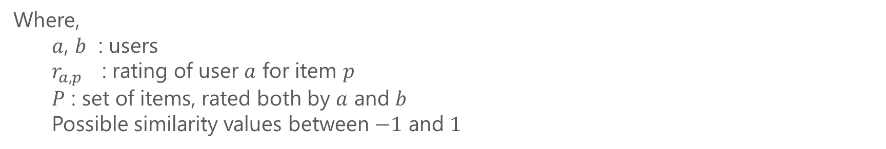

Measuring User Similarity: Pearson Correlation
A measure of how strong a relationship is between two variables
$$sim\left(a,b\right)= \frac{\sum_{p ∈P}{(r_{a,p}−{\overline{r}}_{a})(r_{b,p}−{\overline{r}}_{b})}}{\sqrt{\sum_{p ∈P}{{\left(r_{a,p}−{\overline{r}}_{a}\right)}^{2}}}\sqrt{\sum_{p ∈P}{{\left(r_{b,p}−{\overline{r}}_{b}\right)}^{2}}}}$$
Where,
$a$, $b$ : users
$r_{a,p}$ : rating of user $a$ for item $p$
$P$ : set of items, rated both by $a$ and $b$
Possible similarity values between $−1$ and $1$
Notes:
Trainer Notes: Explain the following:
The similarity formula with respect to each and every parameters

Slide 19
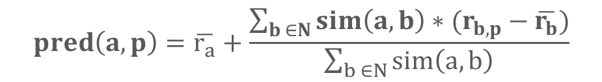
Measuring User Similarity: Pearson Correlation
A common prediction function
 | Item1 | Item2 | Item3 | Item4 | Item5
Alice | 5 | 3 | 4 | 4 | ?
User1 | 3 | 1 | 2 | 3 | 3
User2 | 4 | 3 | 4 | 3 | 5
User3 | 3 | 3 | 1 | 5 | 4
User4 | 1 | 5 | 5 | 2 | 1
sim = 0,85
sim = 0,00
sim = 0,70
sim = -0,79
Making Predictions
$$pred\left(a,p\right)=\overline{r_{a}}+\frac{\sum_{b ∈N}{sim\left(a,b\right)∗(r_{b,p}−\overline{r_{b}})}}{\sum_{b ∈N}{sim\left(a,b\right)}}$$
Notes:
Trainer Notes: Explain the following:
How to get sim values
Making predictions

Slide 20
Item-Based Nearest Neighbor
Uses the similarity between items (and not users) to make predictions
Example:
Look for items that are like Item5
Take Alice ratings for these items to predict the rating for Item5
 | Item1 | Item2 | Item3 | Item4 | Item5
Alice | 5 | 3 | 4 | 4 | ?
User1 | 3 | 1 | 2 | 3 | 3
User2 | 4 | 3 | 4 | 3 | 5
User3 | 3 | 3 | 1 | 5 | 4
User4 | 1 | 5 | 5 | 2 | 1
Notes:
Trainer Notes: Explain the following:
Explain in detail item based nearest neighbour with respect to the above example

Slide 21
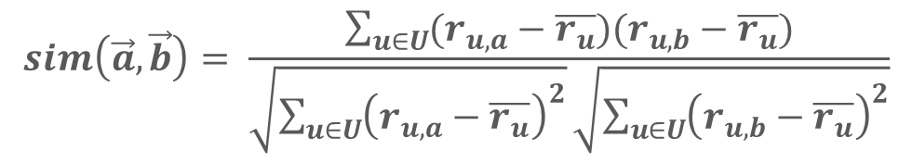

The Cosine and Adjusted Cosine Similarity Measures
Cosine Similarity
Produces better results in item-to-item filtering
Ratings are seen as vectors in n-dimensional space
Similarity is calculated based on the angle between the vectors
$$sim\left(\vec{a},\vec{b}\right)=\frac{\vec{a}∙\vec{b}}{\left|\vec{a}\right|∗|\vec{b}|}$$
Adjusted Cosine Similarity
Takes average user ratings into account
Transforms the original ratings
$$sim\left(\vec{a},\vec{b}\right)= \frac{\sum_{u∈U}{(r_{u,a}−\overline{r_{u}})(r_{u,b}−\overline{r_{u}})}}{\sqrt{\sum_{u∈U}{{\left(r_{u,a}−\overline{r_{u}}\right)}^{2}}}\sqrt{\sum_{u∈U}{{\left(r_{u,b}−\overline{r_{u}}\right)}^{2}}}}$$
Notes:
Trainer Notes: Explain the following:
The formulas
Difference between cosine and adjusted cosine similarity
Significance of cosine and adjusted cosine similarity

Slide 22
Recommender Systems
Topic 3: Association Rule Mining
Notes:
Trainer Notes: Explain the following:
Give an introduction to association rule mining
A real life scenario with respect to association rule mining

Slide 23
Association Rule: Basic Concepts
Given a database of transactions, each transaction is considered as a list of items
Finds all rules that correlate the presence of one set of items with that of another set of items
Concepts
Identifies frequent patterns
Most commonly used for market basket analysis
Notes:
Trainer Notes: Explain the following:
All the four concepts related to association rule mining

Slide 24



Association Rule: Performance Measures
Provides fraction of transactions which contains the item X and Y
Support = No. of times item X occurred / Total number of transactions = P (X ∪ Y))=
Support
Performance Measures
Indicates how often the items X and Y occur together, given the no. of times X occurs
Confidence = No. of times item X and Y occurred / Total occurrence of X = Pr (Y | X) =
Confidence
Indicates the strength of a rule over the random co-occurrence of X and Y
Lift = No. of times item X and Y occurred / Total occurrence of X multiplied by Total occurrence of Y =
Lift
Notes:
Trainer Notes: Explain the following:
All the performance measures like confidence, support and lift
Mathematical calculations for all the parameters

Slide 25
Association Rule: Example
Suppose there are five transactions P1,P2,P3,P4,P5 as given below:
P1 : A, B, C
Here,
A,B,C,D,E are items in a store, I = {A,B,C,D,E}
Set of all transactions P = {P1,P2,P3,P4,P5}
Each transaction is a set of items, P ⊆ I
P2 : A, C, D
P3 : B, C, D
P4 : A, D, E
P5 : B, C, E
Notes:
Trainer Notes: Explain the following:
The above scenario for Market Basket Analysis

Slide 26
Association Rule: Example (Contd.)
Consider, you made some association rules using the transaction database as given below:
A ⇒ D
C ⇒ A
A ⇒ C
B and C ⇒ D
Calculating support, confidence, and lift values for the same will result in the following matrix:
Rule | Support | Confidence | Lift
A ⇒ D | 2/5 | 2/3 | 2/9
C ⇒ A | 2/5 | 2/4 | 1/6
A ⇒ C | 2/5 | 2/3 | 1/6
B and C ⇒ D | 1/5 | 1/3 | 1/9
Notes:
Trainer Notes: Explain the following:
Rule creation
Calculating support, confidence and lift for each of the rules

Slide 27
Association Rule Generation: Apriori Algorithm
Uses frequent itemset to generate association rules
A subset of a frequent itemset must also be a frequent itemset
Frequent itemset is a set of items whose support value > threshold value
Notes:
Trainer Notes: Explain the following:
Apriori algorithm
Significance of apriori algorithm in market basket analysis

Slide 28
Apriori Algorithm: Example
Consider the following transaction dataset
TID | Items
100 | 1 3 4
200 | 2 3 5
300 | 1 2 3 5
400 | 2 5
500 | 1 3 5
Minimum Support Count = 2
Threshold Value = 2
Notes:
Trainer Notes: Explain the following:
The above example
Significance of minimum support count and threshold value

Slide 29
Apriori Algorithm: Step 01
List of one side itemsets are made and their support values are calculated:
CI1
FI1
TID | Items
100 | 1 3 4
200 | 2 3 5
300 | 1 2 3 5
400 | 2 5
500 | 1 3 5
Itemset | Support
{1} | 3
{2} | 3
{3} | 4
{4} | 1
{5} | 4
Itemset | Support
{1} | 3
{2} | 3
{3} | 4
{5} | 4
Since, the threshold value is 2, any itemset with support less than 2 are omitted.
Notes:
Trainer Notes: Explain the following:
The above scenario where any itemset with support less than 2 are omitted

Slide 30
Apriori Algorithm: Step 02
The length of the itemset is extended with 1 (k = k+1)
CI2
FI2
Itemset | Support
{1,2} | 1
{1,3} | 3
{1,5} | 2
{2,3} | 2
{2,5} | 3
{3,5} | 3
TID | Items
100 | 1 3 4
200 | 2 3 5
300 | 1 2 3 5
400 | 2 5
500 | 1 3 5
Itemset | Support
{1,3} | 3
{1,5} | 2
{2,3} | 2
{2,5} | 3
{3,5} | 3
Notes:
Trainer Notes: Explain the following:
Why the length is extended with 1

Slide 31
Apriori Algorithm: Step 03
The length of the itemset is extended. All the combinations of itemsets in FI2 are used.
CI3
TID | Items
100 | 1 3 4
200 | 2 3 5
300 | 1 2 3 5
400 | 2 5
500 | 1 3 5
Itemset | Support
{1,2,3}
{1,2,5}
{1,3,5}
{2,3,5}
Notes:
Trainer Notes: Explain the following:
How the combinations are made
Why is it necessary to build all the possible combinations

Slide 32
Apriori Algorithm: Step 04
Divide your itemset to check if there are any other subsets whose support you haven’t calculated yet.
CI3
Itemset | In FI2?
{1,2,3} {1,2},{1,3},{2,3} | No
{1,2,5} {1,2},{1,5},{2,5} | No
{1,3,5} {1,5},{1,3},{3,5} | Yes
{2,3,5} {2,3},{2,5},{3,5} | Yes
FI2
TID | Items
100 | 1 3 4
200 | 2 3 5
300 | 1 2 3 5
400 | 2 5
500 | 1 3 5
Itemset | Support
{1,3} | 3
{1,5} | 2
{2,3} | 2
{2,5} | 3
{3,5} | 3
Notes:
Trainer Notes: Explain the following:
Why are we suppose to divide the itemset

Slide 33
Apriori Algorithm: Step 05
Using the itemsets of CI3, a new itemset CI4 is created.
TID | Items
100 | 1 3 4
200 | 2 3 5
300 | 1 2 3 5
400 | 2 5
500 | 1 3 5
FI3
CI4
Itemset | Support
{1,3,5} | 2
{2,3,5} | 2
Itemset | Support
{1,2,3,5} | 1
Since, support of CI4 is less than 2, you will stop and return to the previous itemset, CI3.
Notes:
Trainer Notes: Explain the following:
How is this new itemset created
What is the significance of new itemset

Slide 34
Apriori Algorithm: Step 06
Now, you will proceed with subset creation with the obtained list of frequent itemsets:
Itemset | Support
{1,3,5} | 2
{2,3,5} | 2
Confidence Value – 60%
Using this, you will generate all non-empty subsets for each frequent itemset:
For I = {1,3,5}, subsets are {1,3}, {1,5}, {3,5}, {1}, {3}, {5}
For I = {2,3,5}, subsets are {2,3}, {2,5}, {3,5}, {2}, {3}, {5}
For every subset S of I, output is:
S → (I-S) (S recommends I-S)
if support(I) / support(S) >= min_conf value
Notes:
Trainer Notes: Explain the following:
How subset creation works

Slide 35
Apriori Algorithm: Rule Selection
Based on the threshold value, few rules are selected
TID | Items
100 | 1 3 4
200 | 2 3 5
300 | 1 2 3 5
400 | 2 5
500 | 1 3 5
Rule 1: {1,3} → ({1,3,5} - {1,3}) means 1 and 3 → 5
Confidence = support(1,3,5)/support(1,3) = 2/3 = 66.66% > 60%
Rule 1 is selected
Rule 2: {1,5} → ({1,3,5} - {1,5}) means 1 and 5 → 3
Confidence = support(1,3,5)/support(1,5) = 2/2 = 100% > 60%
Rule 2 is selected
Rule 3: {3,5} → ({1,3,5} - {3,5}) means 3 and 5 → 1
Confidence = support(1,3,5)/support(3,5) = 2/3 = 66.66% > 60%
Rule 3 is selected
For set {1,3,5}:
Notes:
Trainer Notes: Explain the following:
Why the above rules are getting selected
What is the meaning of rules getting selected
Significance of threshold values above

Slide 36
Apriori Algorithm: Rule Selection (Contd.)
For set {1,3,5}:
TID | Items
100 | 1 3 4
200 | 2 3 5
300 | 1 2 3 5
400 | 2 5
500 | 1 3 5
Rule 4: {1} → ({1,3,5} - {1}) means 1 → 3 and 5
Confidence = support(1,3,5)/support(1) = 2/3 = 66.66% > 60%
Rule 4 is selected
Rule 5: {3} → ({1,3,5} - {3}) means 3 → 1 and 5
Confidence = support(1,3,5)/support(3) = 2/4 = 50% <60%
Rule 5 is rejected
Rule 6: {5} → ({1,3,5} - {5}) means 5 → 1 and 3
Confidence = support(1,3,5)/support(5) = 2/4 = 50% < 60%
Rule 6 is rejected
Notes:
Trainer Notes: Explain the following:
Why few of the rules are getting rejected

Slide 37
Assisted Practice
Collaborative Filtering
Duration: 20 mins.
Problem Statement: Consider the ratings dataset below, containing the data on: UserID, MovieID, Rating and Timestamp. Each line of this file represents one rating of one movie by one user, and has the following format: UserID::MovieID::Rating::Timestamp
Ratings are made on a 5 star scale with half star increments.
UserID: represents ID of the user
MovieID: represents ID of the movie
Timestamp: represents seconds from midnight Coordinated Universal Time (UTC) of January 1, 1970.
Objective: Predict a User-movie recommendation model.
Access: Click on the Labs tab on the left side panel of the LMS. Copy or note the username and password that are generated. Click on the Launch Lab button. On the page that appears, enter the username and password in the respective fields, and click Login.
Notes:
Trainer Notes:
Explain the above scenario
Download the BX_books_books_ratings_users.zip file for datasets and the corresponding .ipynb file as a reference to demonstrate the above problem
Ask the learners to perform the practice simultaneously on their local system

Slide 38
Unassisted Practice
Collaborative Filtering Duration: 15 mins.
Problem Statement: Consider the ratings dataset below, containing the data on: UserID, MovieID, Rating and Timestamp. Each line of this file represents one rating of one movie by one user, and has the following format: UserID::MovieID::Rating::Timestamp
Ratings are made on a 5 star scale with half star increments.
UserID: represents ID of the user
MovieID: represents ID of the movie
Timestamp: represents seconds from midnight Coordinated Universal Time (UTC) of January 1, 1970.
Objective: Predict a movie-movie recommendation model.
Note: This practice is not graded. It is only intended for you to apply the knowledge you have gained to solve real-world problems.
Access: Click on the Labs tab on the left side panel of the LMS. Copy or note the username and password that are generated. Click on the Launch Lab button. On the page that appears, enter the username and password in the respective fields, and click Login.
Notes:
Trainer Notes: Explain the following:
The above scenario
Ask the learners to download the BX_books_books_ratings_users.zip file to start with the practice

Slide 39
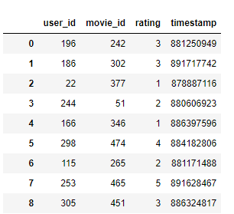
Step 01
Load the ‘Ratings’ movie dataset into pandas with labels
Code
df = pd.read_csv('Recommend.csv',names=['user_id', 'movie_id', 'rating', 'timestamp']) df

Slide 40
Step 02
Create a train test split of 75/25 by declaring number of users and movies
Code
n_users = df.user_id.unique().shape[0] n_movies = df.movie_id.unique().shape[0] train_data, test_data = train_test_split(df, test_size=0.25)

Slide 41
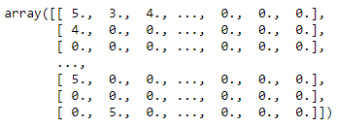
Step 03
Populate the train matrix (user_id x movie_id) with ratings such that [user_id index, movie_id index] = given rating
Code
train_data_matrix = np.zeros((n_users, n_movies)) for line in train_data.itertuples(): #[user_id index, movie_id index] = given rating. train_data_matrix[line[1]-1, line[2]-1] = line[3] train_data_matrix

Slide 42
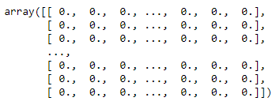
Step 04
Populate the test matrix (user_id x movie_id) with ratings such that [user_id index, movie_id index] = given rating
Code
test_data_matrix = np.zeros((n_users, n_movies)) for line in test_data.itertuples(): #[user_id index, movie_id index] = given rating. test_data_matrix[line[1]-1, line[2]-1] = line[3] test_data_matrix
Notes:
Trainer notes:
Explain the output

Slide 43
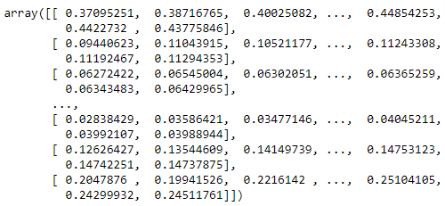
Step 05
Create cosine similarity matrices for movies and predict a movie-movie recommendation model
Code
movie_similarity = pairwise_distances(train_data_matrix.T, metric='cosine’)
movie_pred = train_data_matrix.dot(movie_similarity) / np.array([np.abs(movie_similarity).sum(axis=1)]) movie_pred

Slide 44
Now, you are able to:
Build recommender model using python
Understand mechanism of association rule mining
Demonstrate apriori algorithm

Slide 45

©Simplilearn. All rights reserved

Slide 46
Which of the following would most indicate a situation, where user-user collaborative filtering would be strongly preferable for content-content based filtering?
1
The items recommended don’t have good attributes or keywords to describe them.
Only implicit ratings are available.
Most users have rated a core set of popular items, though they have different tastes on that set.
There are lots of items to recommend and relatively few users.

Slide 47
Which of the following would most indicate a situation, where user-user collaborative filtering would be strongly preferable for content-content based filtering?
1
The items recommended don’t have good attributes or keywords to describe them.
Only implicit ratings are available.
Most users have rated a core set of popular items, though they have different tastes on that set.
There are lots of items to recommend and relatively few users.
a. The items recommended don’t have good attributes or keywords to describe them.
User-user collaborative filtering is strongly preferable when, the items recommended don’t have good attributes or keywords to describe them or less number of items.

Slide 48
Which of the following is not a requirement for a successful user-user collaborative filtering system?
2
Users tastes must either be stable (individual) or changing. If changing, they change in sync with other users' tastes.
The domain in which you are performing collaborative filtering is scoped such that people who agree within one part of that domain generally agree within other parts of the domain.
Past agreement between users is predictive of future agreement.
Users mostly have similar tastes on a set of popular items, though they may have individually different tastes on unpopular items.

Slide 49
Which of the following is not a requirement for a successful user-user collaborative filtering system?
2
Users tastes must either be stable (individual) or changing. If changing, they change in sync with other users' tastes.
The domain in which you are performing collaborative filtering is scoped such that people who agree within one part of that domain generally agree within other parts of the domain.
Past agreement between users is predictive of future agreement.
Users mostly have similar tastes on a set of popular items, though they may have individually different tastes on unpopular items.
d. Users mostly have similar tastes on a set of popular items, though they may have individually different tastes on unpopular items.
If the users mostly have similar tastes on a set of popular items, it calls for hybrid or item-based collaborative filtering.

Slide 50
Lesson-End Project
Duration: 20 mins.
Problem Statement: BookRent is the largest online and offline book rental chain in India. The company charges a fixed and rental fee for a book per month. Hence, the company gets more money for rented books. Since, most of the users returning the books and not taking rentals, the company wants to increase the revenue and profit.
Objective: You as an ML expert have to model a recommendation engine so that user gets recommendations of books based on the behaviour of similar users. This will ensure that users are renting books based on their individual taste.
Access: Click the Labs tab in the left side panel of the LMS. Copy or note the username and password that are generated. Click the Launch Lab button. On the page that appears, enter the username and password in the respective fields and click Login.
Notes:
Trainer Notes: Explain the project to the learners and instruct them to perform it after the lesson. Also, ask them to download recommend.csv for the same.

Slide 51
©Simplilearn. All rights reserved

